Slide 1
Smash&Constructを用いた Deepfake text検出器の性能調査
Performance investigation of Deepfake Text detector using Smash&Construct
研究室ゼミ
大町・宮崎研究室 修士１年 石川健志

Slide 2
Index
Introduction
Previous content
Today’s topic
Conclusion

Slide 3
Introduction
Introduction
Previous content
Today’s topic
Conclusion

Slide 4

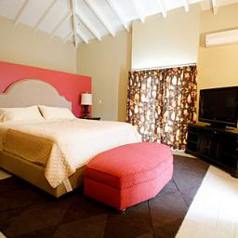
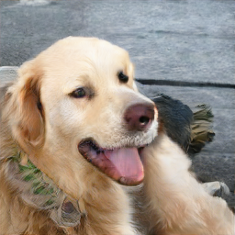
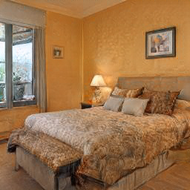
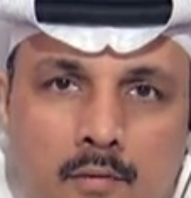
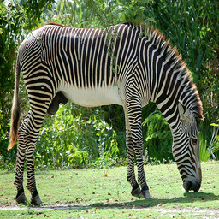
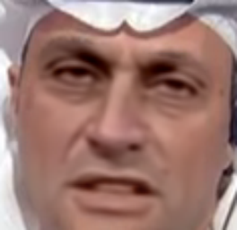
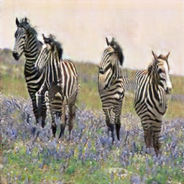
What is Deepfake?
Images and videos generated by AI
Real Image
Deepfake

Slide 5
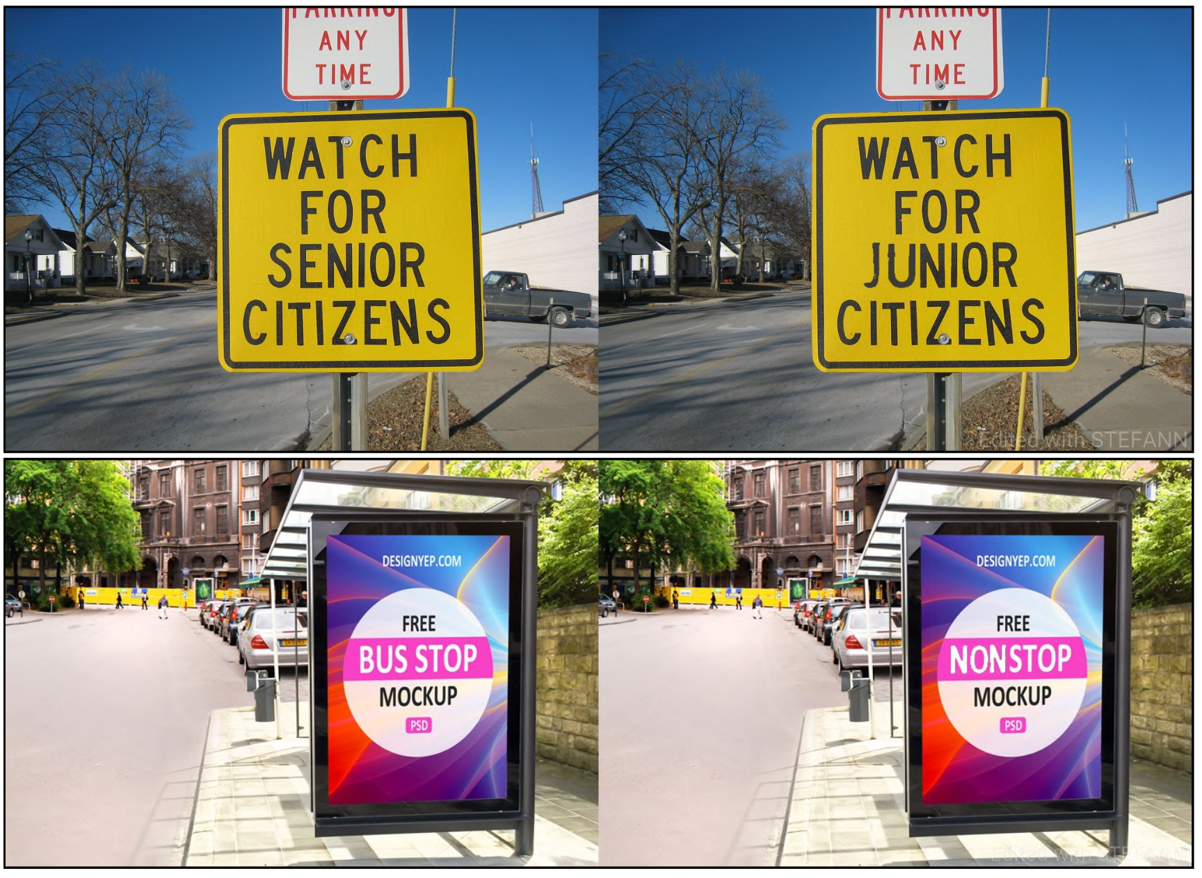
What is Deepfake text?
The text part of the image has been tampered with by AI.
Editing by AI
Natural Images
Deepfake text

Slide 6
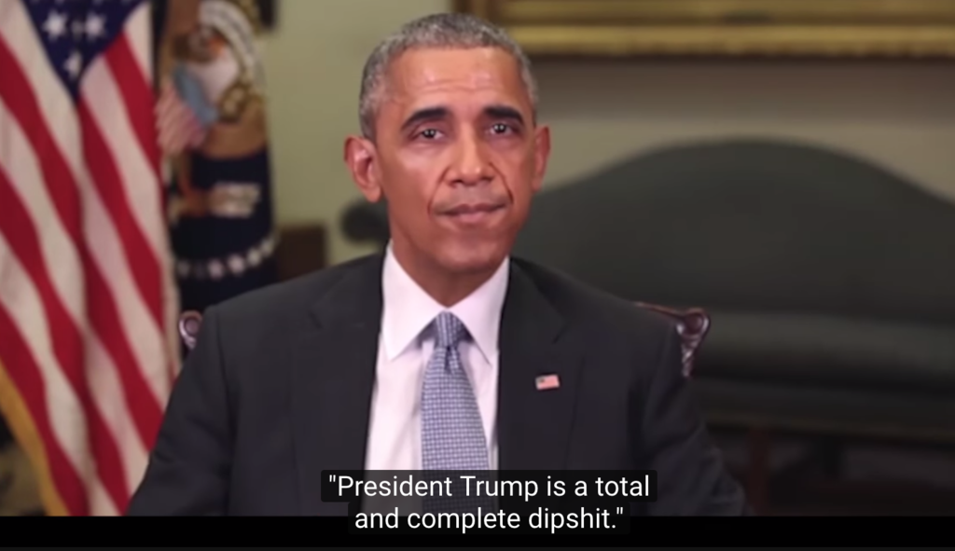
Problems caused by Deepfake
Generative AI has developed remarkably in recent years, and deepfake cannot be distinguished by the human eye
In particular, deepfake, which manipulates people's faces, has caused various problems
source：https://youtu.be/cQ54GDm1eL0

Slide 7
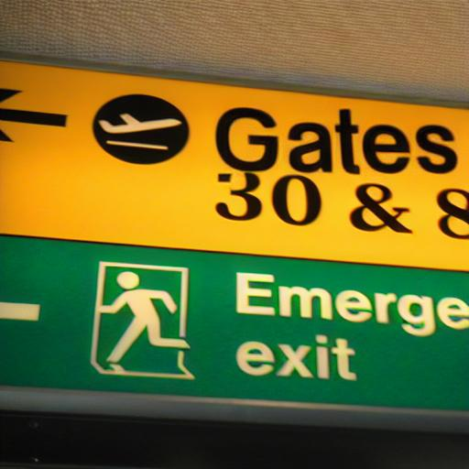


The Current Work of Deepfake Detection
Research on deepfake detection by manipulating the face is being actively conducted
High social risk
Very little research has been done on deepfake detection of text in images
Existing generative AI is not good at drawing characters correctly and naturally
However, modern generative AI can also draw characters

Slide 8
What is the generalized performance of a detector?
It is easy to improve detection performance for data from known models in the training data, but detection performance is significantly degraded for data from unknown models^{[1]}
Generalization to unknown models is a common challenge in deepfake detection
model A
model A
model B
detector
detector
model C
model B
model D
train
test
Notes:
deepfake検出器の一般的な特性

Slide 9
The need for deepfake text detection
Deepfakes with edited text, not just faces, can pose a risk.
Replacing signs and labels
Because this is an unprecedented topic, there is no prior research and no data set.
We developed a dataset of images with redacted text and a general-purpose detector model that can detect them.

Slide 10
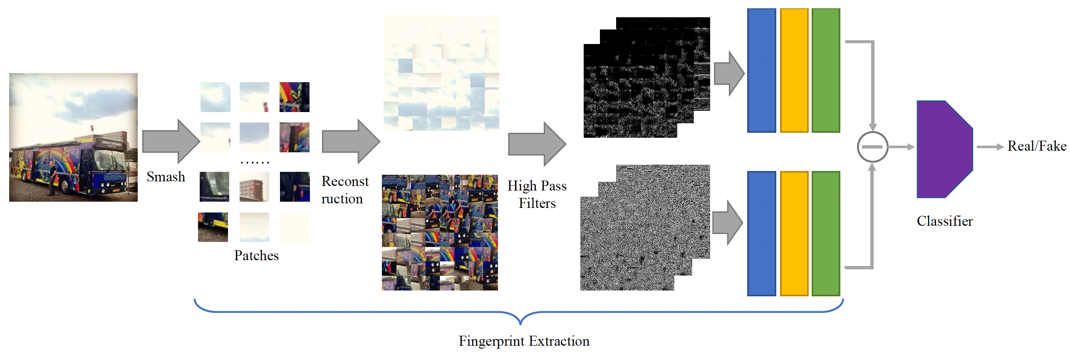
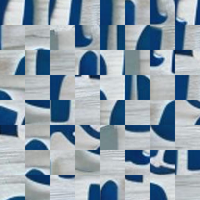
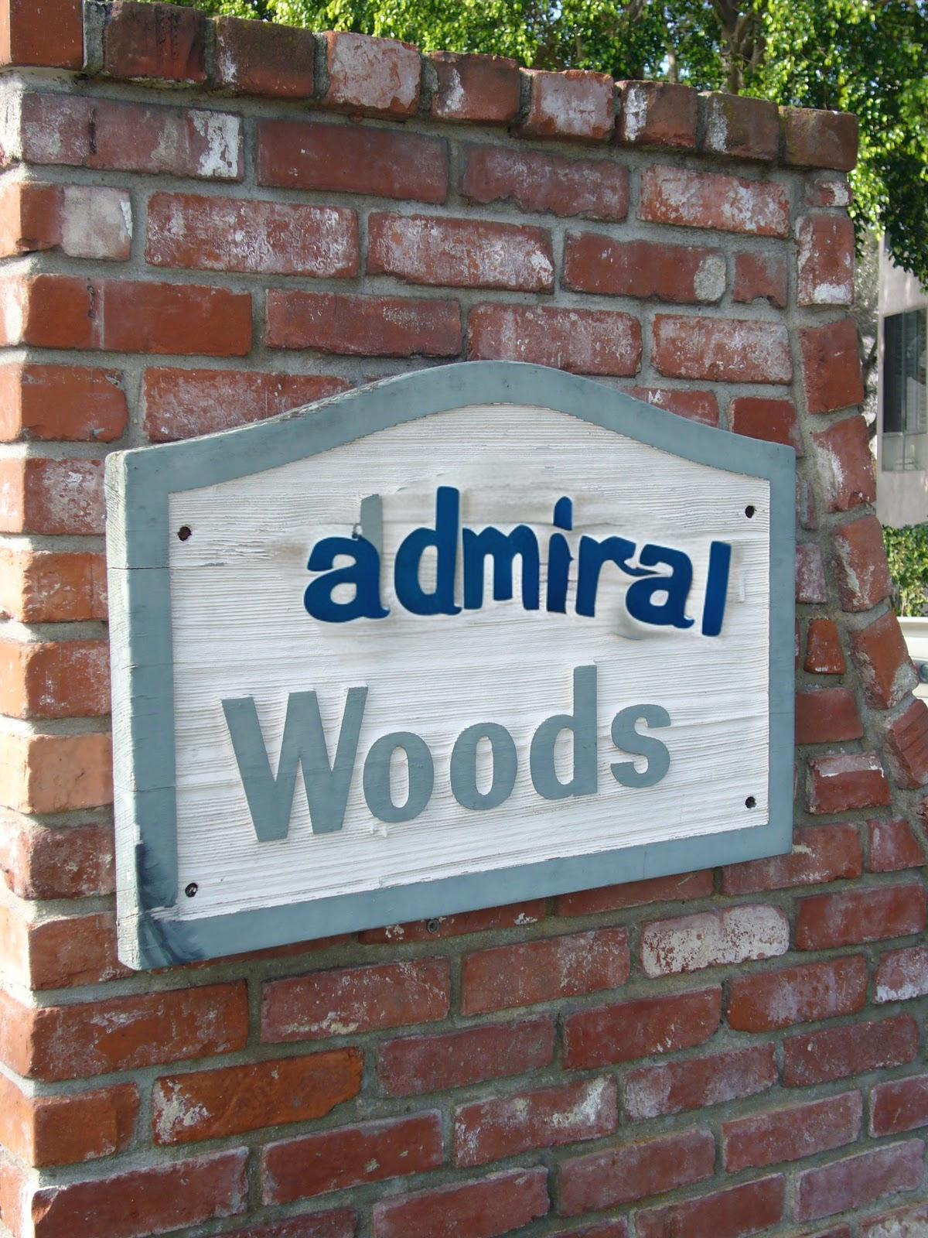
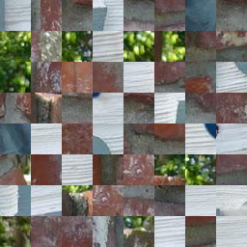
Today’s Contents
Review of the Deepfake text dataset
Experiment of applying a normal deepfake detector with high generalization performance to deepfake text
PatchCraft^{[2]}, which has excellent generalization performance in normal deepfake detection tasks, Applied to deepfake text datasets to verify generalization performance
Achieves higher generalization performance than ResNet

Slide 11
Today’s topic
Investigating the generalization performance of detectors using PatchCraft
Attention area analysis using GradCAM
Smash&Construct ablation experiment
Comparative experiments with different model structures
Why is it possible to demonstrate high generalization performance?
What elements are important?

Slide 12
Previous content
Introduction
Previous content
Today’s topic
Conclusion

Slide 13
Previous experimental results
All training is done using DiffSTE datasets
Average Precision ↑
 | DiffSTE | TextDiffuser | UDiffText | Average
ResNet50 | 92.3 | 77.4 | 90.6 | 86.8
PatchCraft* | 98.1 | 92.3 | 96.1 | 95.5

Slide 14
Ideas for PatchCraft^{[2]}
To detect deepfake images, we should focus on the fine texture differences rather than the global semantic information of the image.
Traces of generative models tend to appear in the high-frequency regions of generated images.
They propose Smash&Construct to destroy global semantic information of images.
30 types of high pass filters are used to focus on high frequency ranges

Slide 15
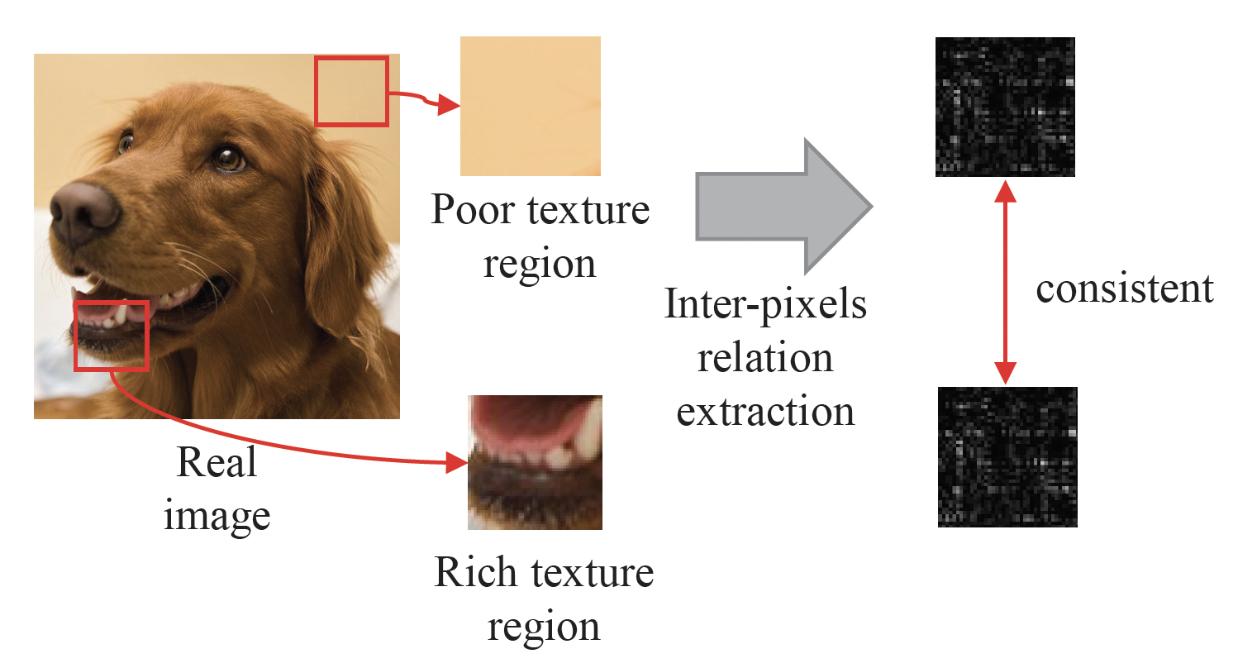
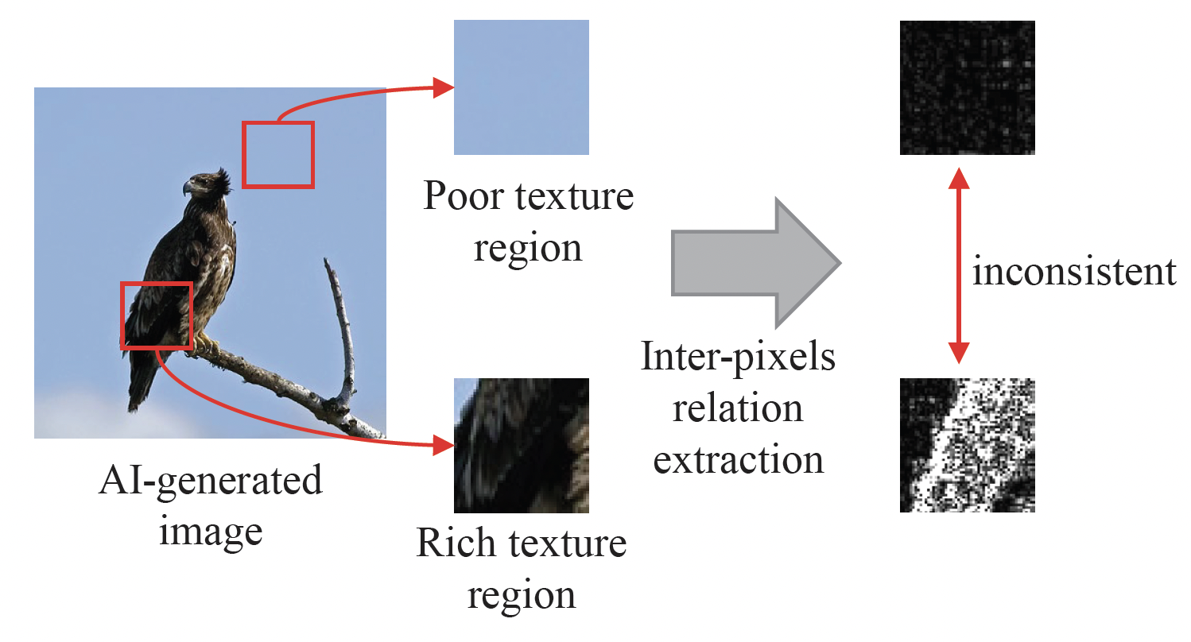
Ideas for PatchCraft^{[2]}
Generative models such as GANs and diffusion models have a relatively difficult time rendering complex textured regions compared to simple textured regions.
Detect deepfakes by comparing pixel correlations between simple and complex texture regions

Slide 16
PatchCraft^{[2]}
192 random 32x32 patches are extracted from the image, and two images are reconstructed from them, one representing the top 33% and the other representing the bottom 33% in terms of texture complexity.
→ Destroys global semantic information of images
High-frequency features are extracted from each reconstructed image and compared to detect deepfakes.

Slide 17
Application to Deepfake Text
Applying the idea of ​​PatchCraft^{[2]} to detect Deepfake text

Slide 18
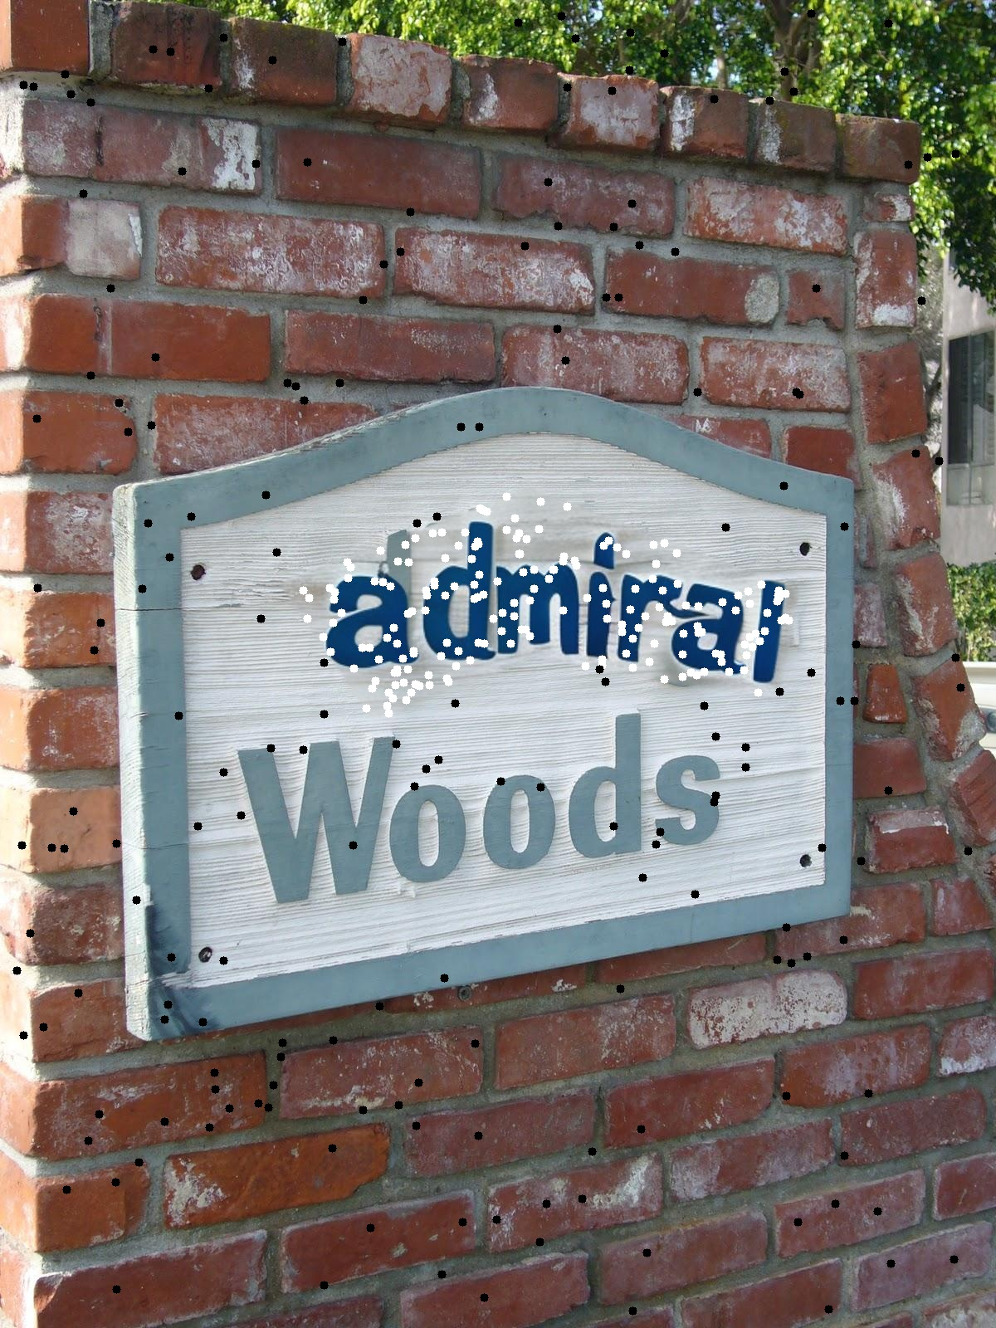
Application to Deepfake text
Application to Deepfake text: We use the ideas of PatchCraft^{[2]} to detect Deepfake text.
Extract patches from text and non-text areas and reconstruct the image
text texture
other texture

Slide 19
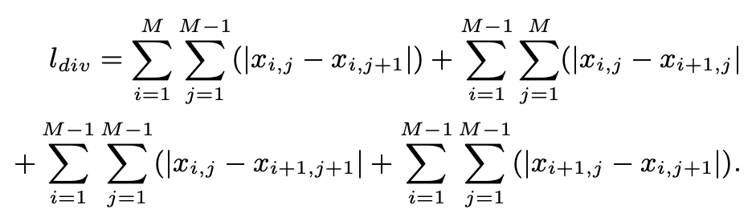
Application to Deepfake text
Sort patches by texture complexity
Arranged from top left to bottom right
Choose both with high texture complexity
→ Comparing the high-frequency regions of natural images with those rendered by a generative model
Select text textures in order of complexity, other textures in order of least complexity.
→ Comparing the low-frequency regions of natural images with the high-frequency regions drawn by a generative model
Texture Complexity Formula
text texture
other texture

Slide 20
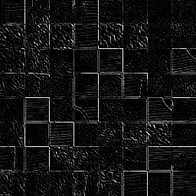
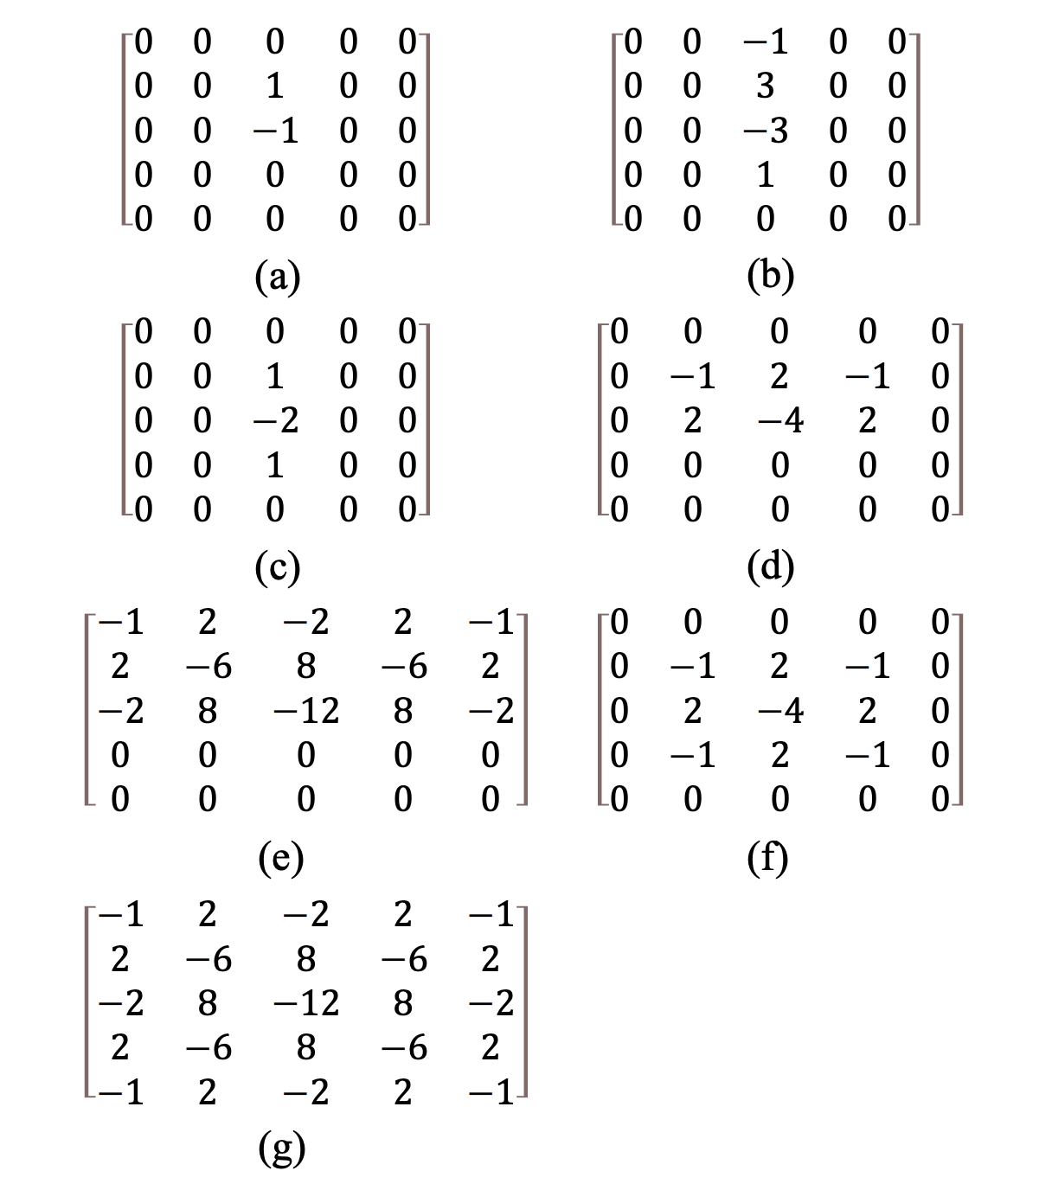
Application to Deepfake text
By using the high-pass filter proposed in SRM^{[3]}, semantic information is further suppressed and texture is further emphasized.
text texture
text texture
High-pass filter×30
other texture
other texture

Slide 21
Application to Deepfake text
The texture patches passed through the high-pass filter are classified as real or fake by simple multiple convolution layers.
text texture
other texture

Slide 22
Overall view of the model
Comparing the generalization performance of ResNet50 and PatchCraft using a newly created dataset
Input into PatchCraft with fake text area specified

Slide 23
Previous experimental results
All training is done using DiffSTE datasets
Generalization performance superior to ResNet50
Average Precision ↑
 | DiffSTE | TextDiffuser | UDiffText | Average
ResNet50 | 92.3 | 77.4 | 90.6 | 86.8
PatchCraft* | 98.1 | 92.3 | 96.1 | 95.5

Slide 24
Today‘s topic
Introduction
Previous content
Today’s topic
Conclusion

Slide 25
Today’s topic
Investigating the generalization performance of detectors using PatchCraft
Attention area analysis using GradCAM
Smash&Construct ablation experiment
Comparative experiments with different model structures
Why is it possible to demonstrate high generalization performance?
What elements are important?

Slide 26
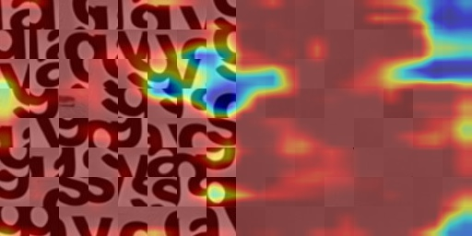
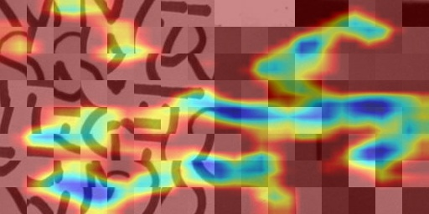
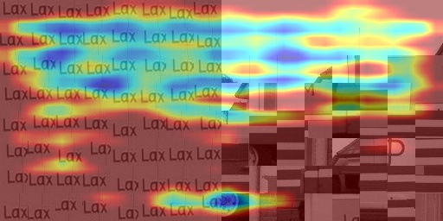
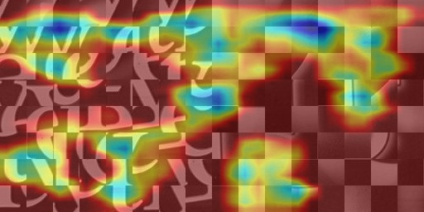
Attention area analysis using GradCam
Output as a heat map which parts of the image have a large influence on the model output
True positive example
False positive example

Slide 27
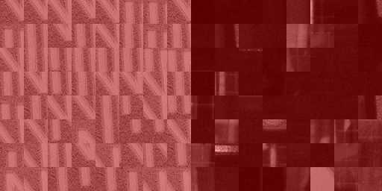
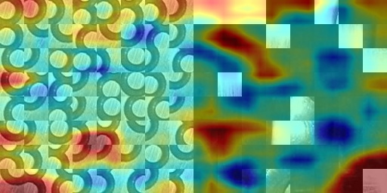
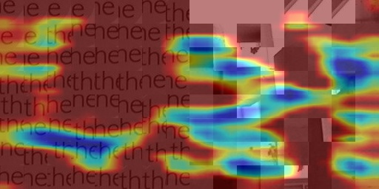
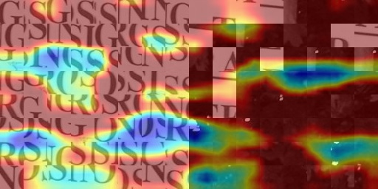
Attention area analysis using GradCam
Output as a heat map which parts of the image have a large influence on the model output
True negative example
False negative example

Slide 28
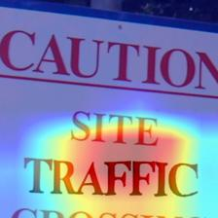
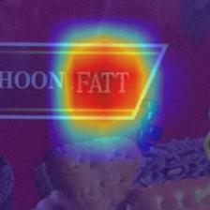
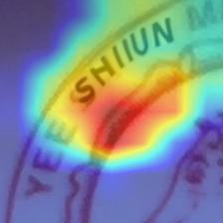
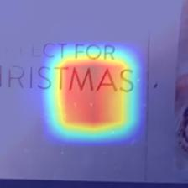
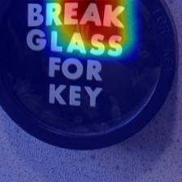
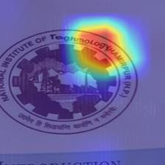
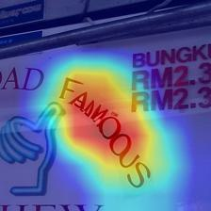
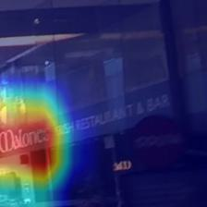
GradCAM(ResNet50)
Output as a heat map which parts of the image have a large influence on the model output
True positive example
False positive example

Slide 29
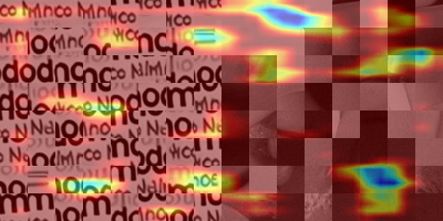
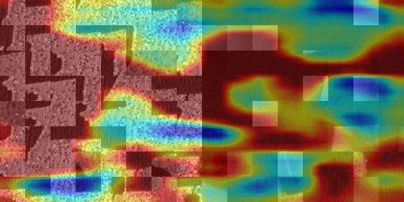
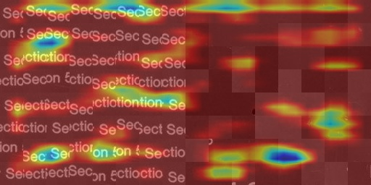
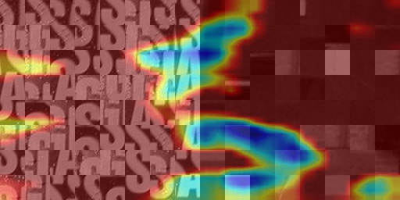
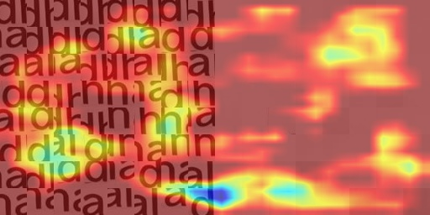
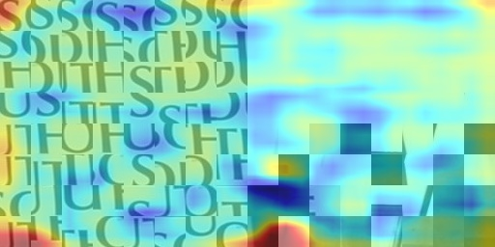
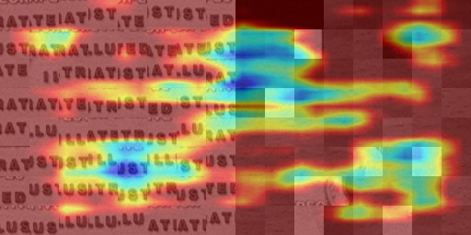
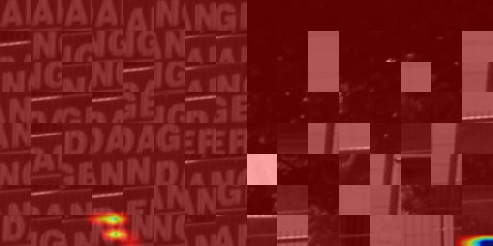
Attention area analysis using GradCam
Compared to ResNet, it is difficult to know which part of the image is being focused on.
Are you often focusing on the entire image, and are you able to focus on fine textures by destroying global semantic information with Smash & Construct?
Detecting deepfake regions using GradCAM is difficult
Deepfake image
Real image
True positive example
False negative example
False positive example
True negative example

Slide 30
Ablation experiment of Smash&Construct
Investigating which parts of the Smash&Construct strategy are effective against deepfake text
high pass filter
Patch sampling from text part
Sorting patches by texture complexity
Should we focus on the high frequency range?
Should we pay attention to the text part?
Should patches be sorted?

Slide 31
Experimental results
high pass filter
Patch sampling from text part
Sorting patches by texture complexity
Average Precision ↑
 | DiffSTE | TextDiffuser | UDiffText | Average
PatchCraft* | 98.1 | 92.3 | 96.1 | 95.5
ResNet50 | 92.3 | 77.4 | 90.6 | 86.8
w/o 1 | 97.1 | 85.4 | 94.6 | 92.4
w/o 2 | 83.8 | 83.8 | 83.6 | 83.7
w/o 3 | 98.3 | 91.0 | 96.1 | 95.1

Slide 32
Experimental results
High-pass filter and patch sampling from text part required
There is a big difference whether you pay particular attention to the text part or not.
No need to sort patches
high pass filter
Patch sampling from text part
Sorting patches by texture complexity
Average Precision ↑
 | DiffSTE | TextDiffuser | UDiffText | Average
PatchCraft* | 98.1 | 92.3 | 96.1 | 95.5
w/o 1 | -1.0 | -6.9 | -1.5 | -3.1
w/o 2 | -14.3 | -8.5 | -12.5 | -11.8
w/o 3 | +0.2 | -1.2 | 0 | -0.3

Slide 33
Comparative experiments with different model structures
Is it really necessary to separate the text part and other parts?
It might work just to get the patch from the text part.
Take patch only from text part
In addition to the above, input the image as is without Smash&Construct

Slide 34
Experimental results
Take patch only from text part
In addition to the above, input the image as is without Smash&Construct
Average Precision ↑
 | DiffSTE | TextDiffuser | UDiffText | Average
PatchCraft* | 98.1 | 92.3 | 96.1 | 95.5
ResNet50 | 92.3 | 77.4 | 90.6 | 86.8
1 | 98.1 | 91.4 | 96.3 | 95.2
2 | 85.0 | 84.9 | 84.8 | 84.9

Slide 35
Experimental results
It is enough to take the patch only from the text part.
Smash&Construct is also effective for deepfake text
Take patch only from text part
In addition to the above, input the image as is without Smash&Construct
Average Precision ↑
 | DiffSTE | TextDiffuser | UDiffText | Average
PatchCraft* | 98.1 | 92.3 | 96.1 | 95.5
1 | 0 | -0.9 | +0.2 | -0.2
2 | -13.1 | -7.3 | -11.3 | -10.6

Slide 36
Summary of experiment
Investigating the generalization performance of detectors using PatchCraft
Attention area analysis using GradCAM
Smash&Construct ablation experiment
Comparative experiments with different model structures
It focuses on the texture of the entire image rather than semantic information.
It is most effective to obtain patches from the text part, the order does not matter
No need to retrieve patches from areas outside the text

Slide 37
Conclusion
Introduction
Previous content
Today’s topic
Conclusion

Slide 38
Conclusion
Investigating the generalization performance of detectors using PatchCraft
Attention area analysis using GradCAM
Smash&Construct ablation experiment
Comparative experiments with different model structures
It focuses on the texture of the entire image rather than semantic information.
It is most effective to obtain patches from the text part, the order does not matter
No need to retrieve patches from areas outside the text
Future work
It is troublesome to specify the text part in advance and make judgments.
I want to build a general-purpose model that can detect all deepfake parts in an image with a single inference.
Expansion of dataset

Slide 39
参考文献
Pei, Gan, et al. "Deepfake generation and detection: A benchmark and survey." arXiv preprint arXiv:2403.17881 (2024).
Zhong, Nan, et al. "Rich and poor texture contrast: A simple yet effective approach for ai-generated image detection." arXiv preprint arXiv:2311.12397 (2023).
Jessica Fridrich and Jan Kodovsky. Rich models for steganalysis of digital images. IEEE Transactions on information Forensics and Security, 7(3):868–882, 2012. 5

Slide 40
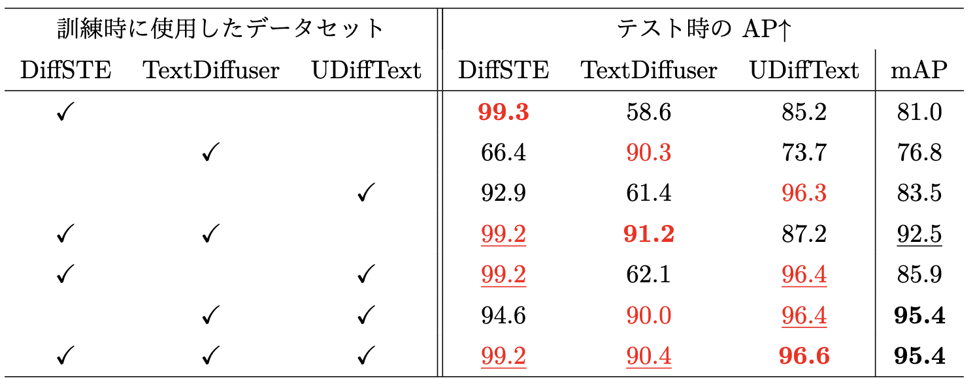
Previous Contents
Creating a Deepfake Text Dataset
Detection experiment by ResNet50 and confirmation of generalization performance
Investigate what the detection model uses to judge deepfake text
Deepfake text detection experiment by ResNet50

Slide 41
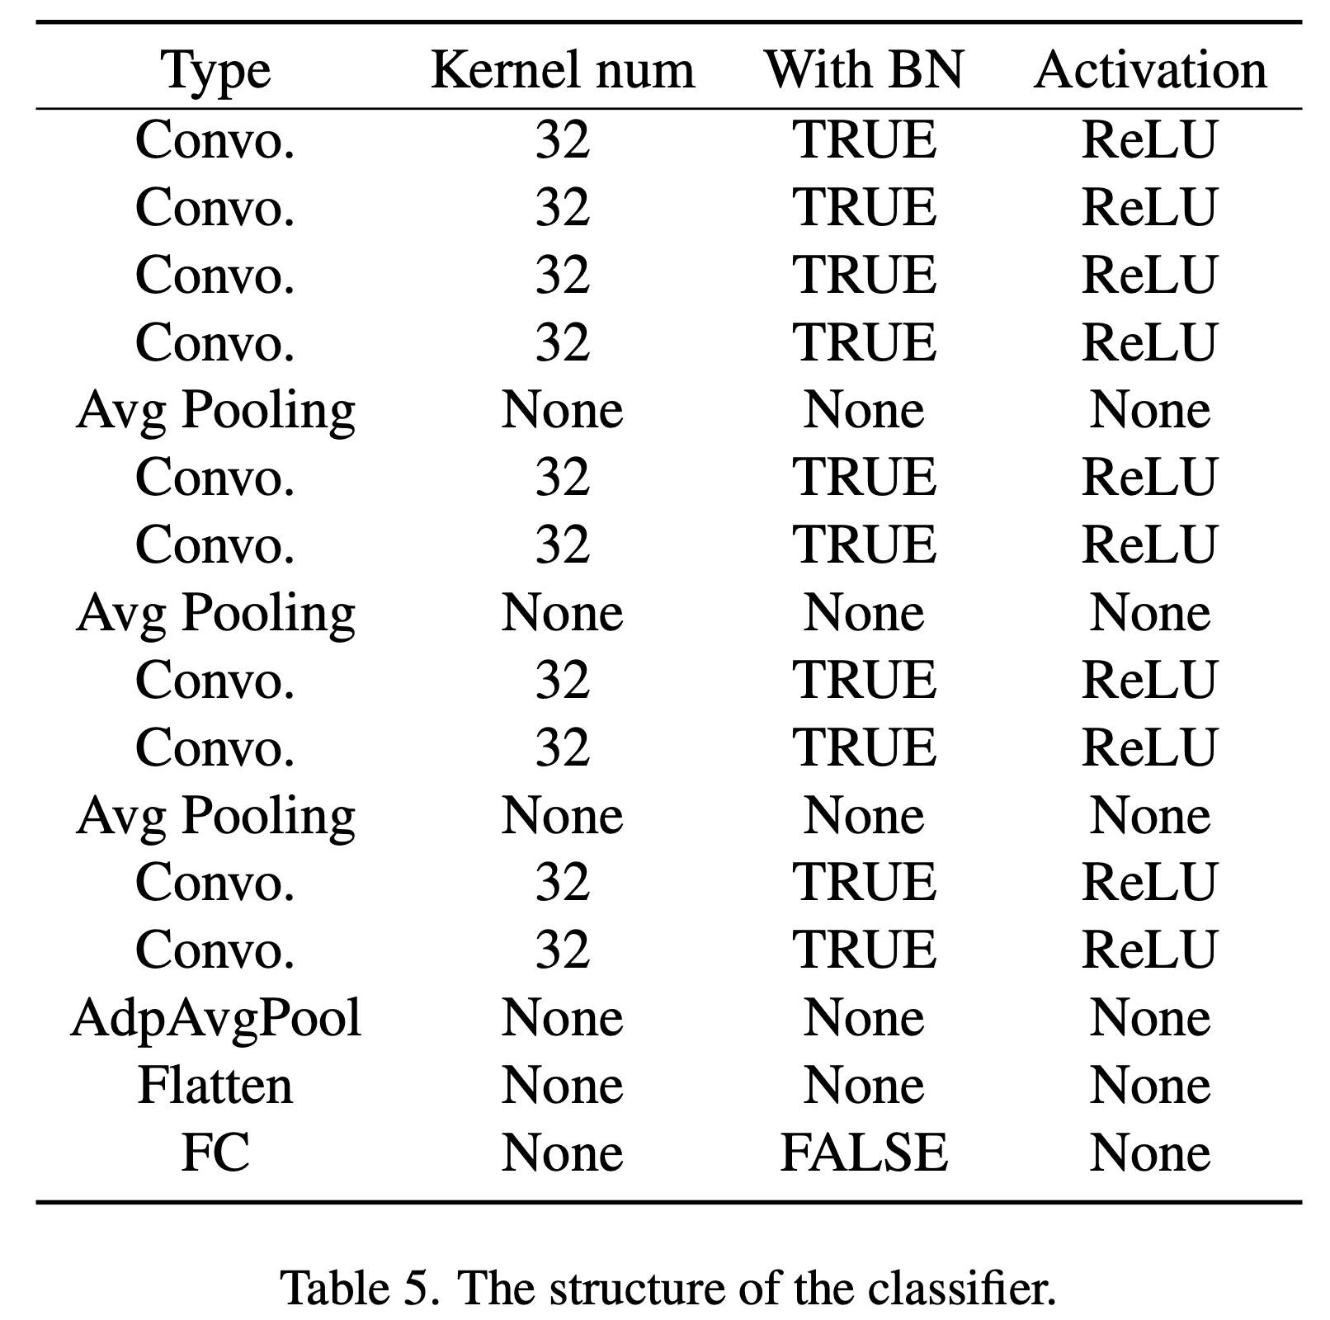
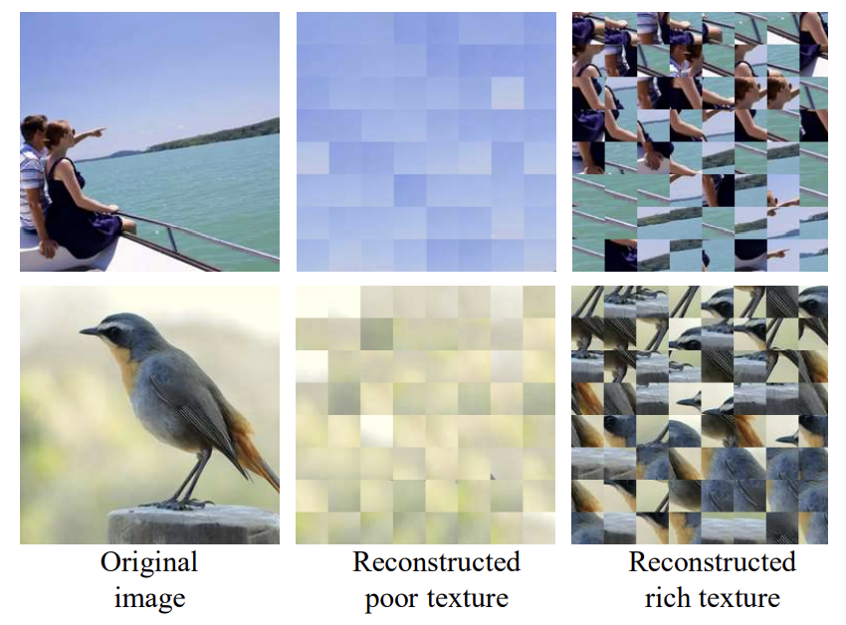
PatchCraft補足

